Slide 1

DATA ANALYTICS AND VISUALIZATION
PROJECT
AYUSH KUMAR MISHRA (12240340)
AKSHAT KUMAR (12240080)
ADITYA PRAKASH (12240040)

Slide 2

ANALYSIS AND VISUALIZING THE IMPACT OF G20 AND MODELLING THE REACTION
A Social Media Analytics Approach

Slide 3

Real-time indicators: Twitter and YouTube
Due to the nature of their platforms Twitter and YouTube are often considered real-time indicators .The way information is disseminated and consumed on them provides the real time indications.
Instantaneous Updates
User-Generated Content
Global Reach
Hashtags and Trends
Live Updates and Notifications
Engagement Metrics

Slide 4
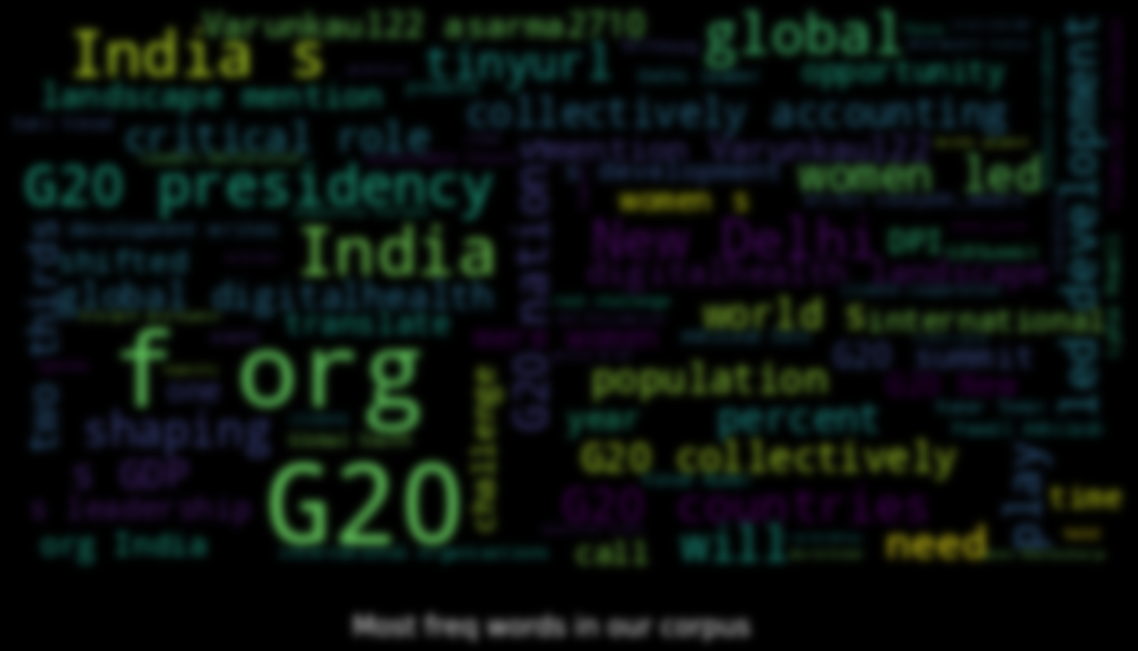
Insights into public mood, concerns, and reactions
A well structured social space is provided on Social media platforms for people to share their opinions and engage in discussions about the trending topics, as we have analyzed on G20. Amplification and influences of the conversations happening on these platforms on public sentiment can be studied.

Slide 5
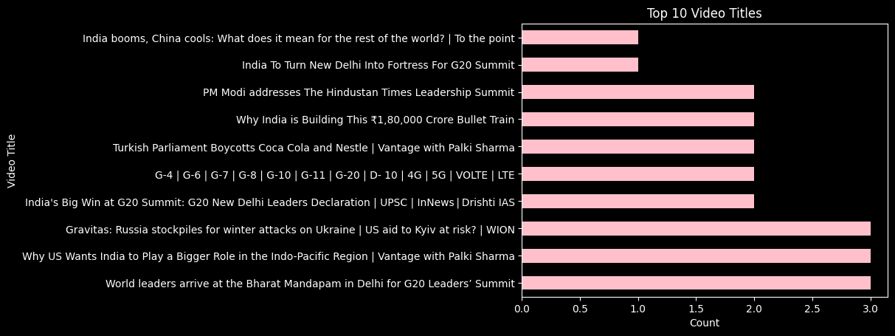



Slide 6

Articles/Blogs
A new model of inclusive diplomacy forged by India.—Kapil Sharma , the senior director of the Atlantic Council’s South Asia Center.
While Xi ‘contained’ himself ,Modi cemented his leadership of the Global South.—Michael Schuman , a nonresident senior fellow at the Atlantic Council’s Global China Hub and a contributing writer for the Atlantic magazine.
India’s growing power showcased by the G20. The limits of its foreign policy could also be exposed.— Chatham House; The Royal Institute of International Affairs
India's growing global clout showcased via G20, as well as worries over press freedom. — NBC NEWS
India as a ‘vishwaguru’ , a attempt of Modi government’s to portray the visage of Modi alone on billboards everywhere has drawn a response from those watching. — THE WIRE

Slide 7
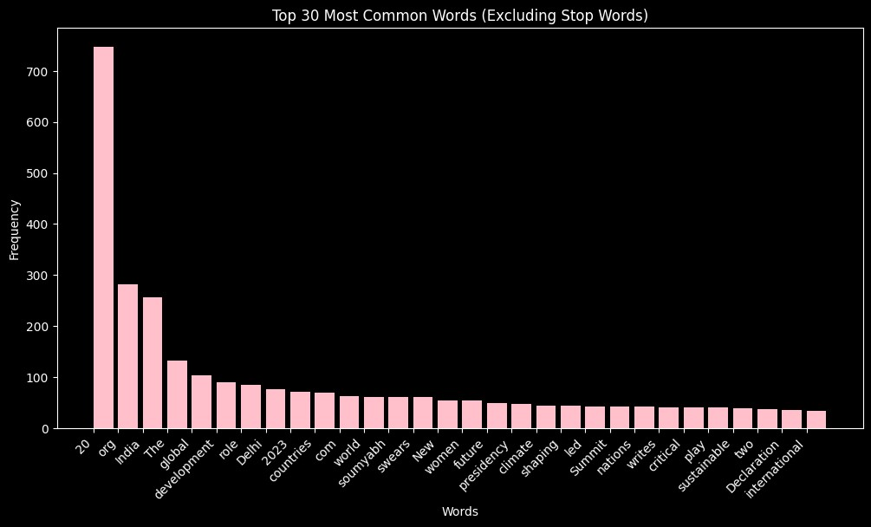

Slide 8
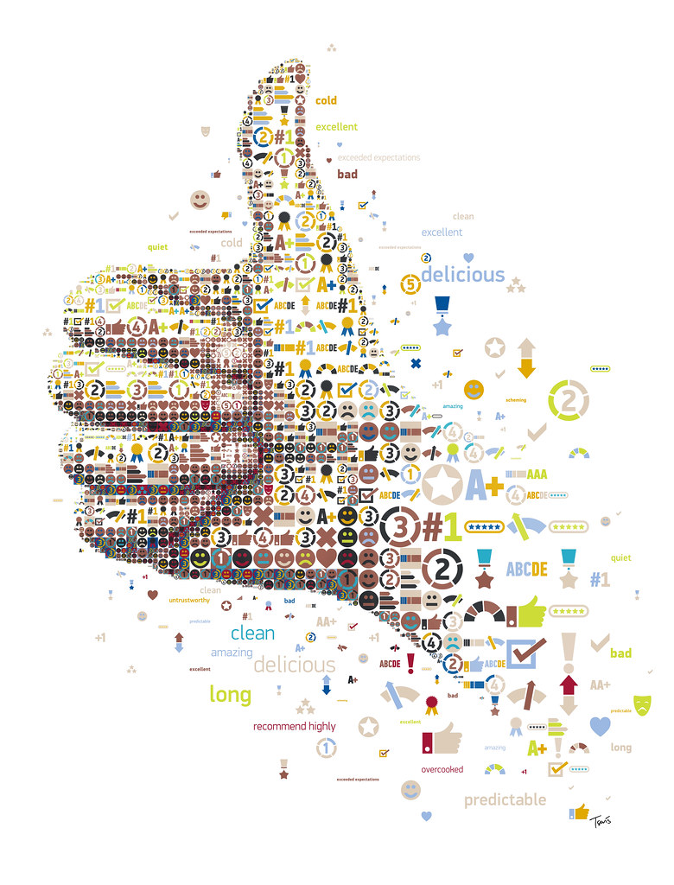
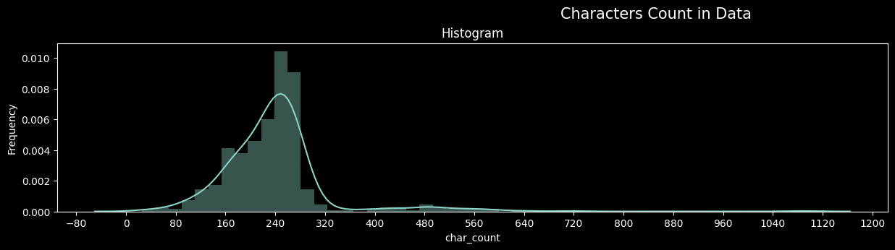
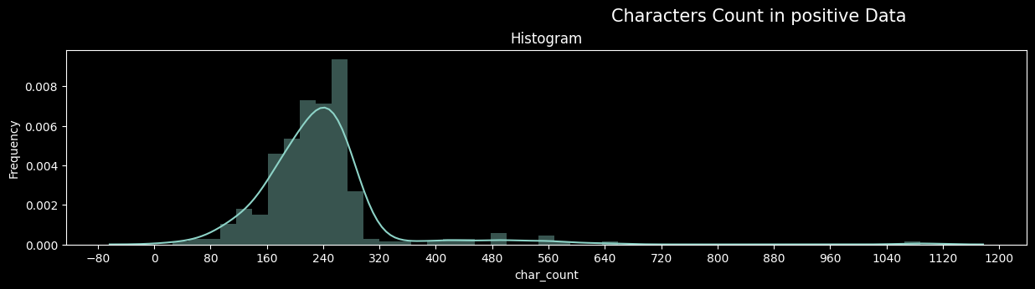
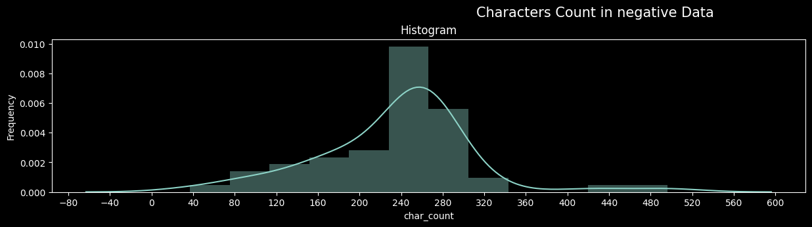

Slide 9

Sentiment Analysis.
We performed sentiment analysis on the tweets and youtube video comments to determine their polarity after preprocessing,, i.e., whether they express positive, negative, or neutral sentiment towards the Indian G20 presidency.
Utilized the TextBlob library to perform sentiment analysis on the cleaned comments, categorizing them as Positive, Neutral, or Negative

Slide 10
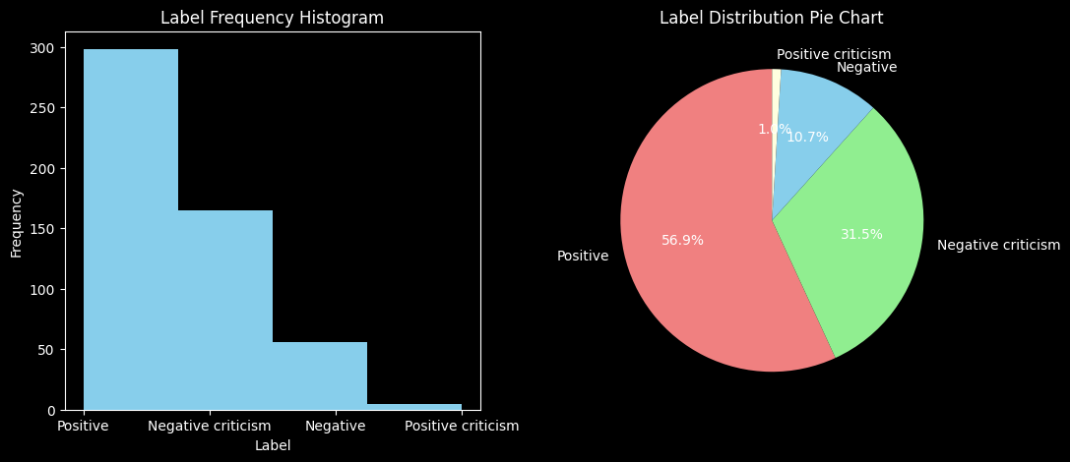
Twitter Sentiment Analysis Report

Slide 11
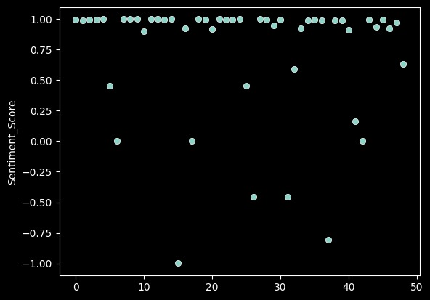
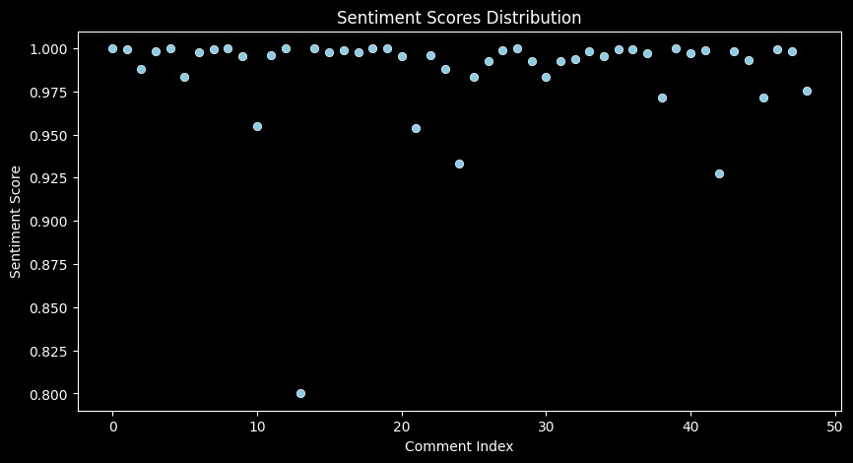
YOUTUBE Sentiment Analysis Report
USING NLKT
DEEP LEARNING APPROACH

Slide 12
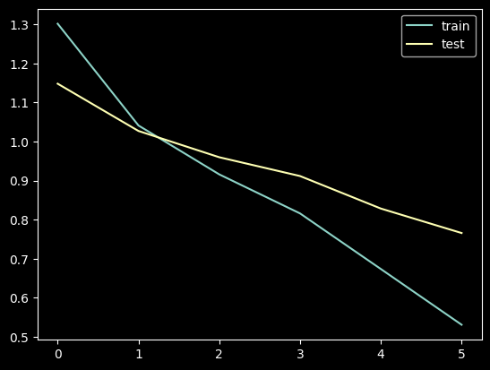
tensorlfow-keras modelling
TensorFlow-Keras is a high-level neural networks API that is a part of TensorFlow ecosystem.
A powerful and user-friendly tool for building and training deep learning models.

Slide 13

FINAL THOUGHTS
As we performed our study on the data through social media analysis, we arrive to the thoughts that this analysis is instrumental in providing real-time, diverse, and nuanced insights into public sentiment, contributing to a holistic comprehension of the impact of international events like the G20 summit. This analysis its complements traditional forms and enhances the ability to capture the multifaceted nature of public reactions. Public reaction vary depending on how the related issues are prioritized and the effectiveness of their proposed solutions.

Slide 14
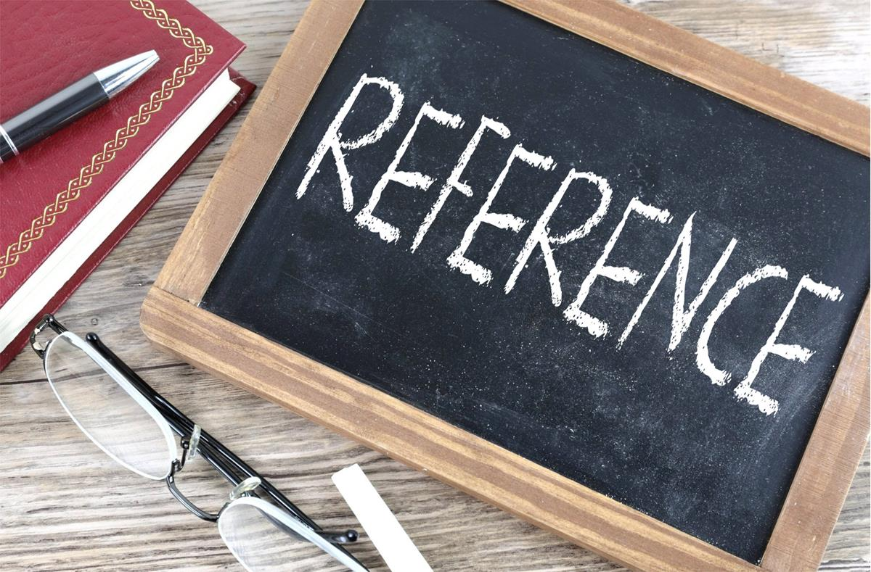
https://www.atlanticcouncil.org/
https://www.nbcnews.com/
https://www.chathamhouse.org/
https://twitter.com/home
https://www.youtube.com/
https://www.businesstoday.in/
https://byjus.com/

Slide 15


